Slide 1
Module 11: Data Storage Structure

Slide 2
Outline
Storage Access
File Organization
Organization of Records in Files
Data-Dictionary Storage

Slide 3
Storage Access

Slide 4
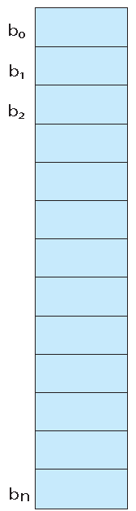
Database File
A database file is partitioned into fixed-length storage units called blocks. Blocks are units of both storage allocation and data transfer.
A database file is stored permanently on disk and moved (partially) temporary to main memory.

Slide 5
Data Transfer Between Memory and Disk
The main memory is broken into fixed-length storage units called frames (pages).
The disk is broken into fixed-length storage units called blocks.
When a database file is accessed by an SQL query, some of the file blocks are transferred to main memory
Database system seeks to minimize the number of block transfers between the disk and memory. We can reduce the number of disk accesses by keeping as many blocks as possible in main memory.
Buffer – portion of main memory available to store copies of disk blocks.
Buffer manager – subsystem responsible for allocating buffer space in main memory.

Slide 6
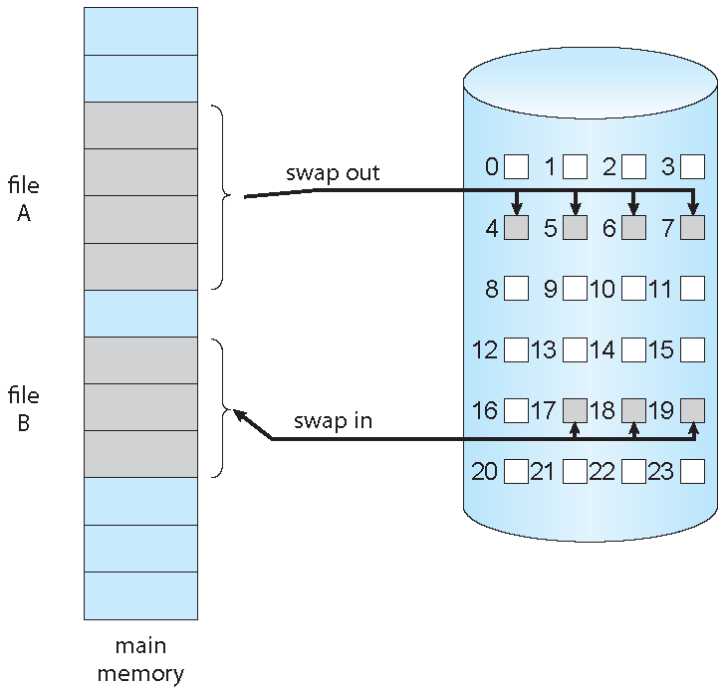
Data Transfer Between Memory and Disk (Cont.)

Slide 7
Buffer Manager
Programs call on the buffer manager when they need a block from disk.
  If the block is already in the buffer, buffer manager returns the address of the block in main memory
  If the block is not in the buffer, the buffer manager
    Allocates space in the buffer for the block
      Replacing (throwing out) some other block, if required, to make space for the new block.
      Replaced block written back to disk only if it was modified since the most recent time that it was written to/fetched from the disk.
    Reads the block from the disk to the buffer, and returns the address of the block in main memory to requester.

Slide 8
Buffer-Replacement Policies
Most operating systems replace the block via the least recently used (LRU) strategy
Idea behind LRU – use past pattern of block references as a predictor of future references
Queries have well-defined access patterns (such as sequential scans), and a database system can use the information in a user’s query to predict future references
  LRU can be a bad strategy for certain access patterns involving repeated scans of data
    For example: when computing the join of 2 relations r and s by a nested loops
    for each tuple tr of r do
    for each tuple ts of s do
    if the tuples tr and ts match …
  Mixed strategy with hints on replacement strategy provided
  by the query optimizer is preferable

Slide 9
Buffer-Replacement Policies (Cont.)
Pinned block – memory block that is not allowed to be written back to disk.
Toss-immediate strategy – frees the space occupied by a block as soon as the final tuple of that block has been processed
Most recently used (MRU) strategy – system must pin the block currently being processed. After the final tuple of that block has been processed, the block is unpinned, and it becomes the most recently used block.
Buffer manager can use statistical information regarding the probability that a request will reference a particular relation
  E.g., the data dictionary is frequently accessed. Heuristic: keep data-dictionary blocks in main memory buffer
Buffer managers also support forced output of blocks for the purpose of recovery (more in Chapter 16)

Slide 10
File Organization and Record Organization

Slide 11
File Organization
The database is stored as a collection of files. Each file is a sequence of records. A record is a sequence of fields.
Fixed-size records
  Assume record size is fixed
  Each file has records of one particular type only
  Different files are used for different relation.
Simple approach:
  Store record i starting from byte n ∗ (i – 1), where n is the size of each record.
  Record access is simple but records may cross blocks
    Modification: do not allow records to cross block boundaries
This case is easiest to implement; we will consider variable length records later.

Slide 12

Deletion of Records
Three ways to handle the deletion of record i :
  move records i + 1, . . ., n to i, . . . , n – 1
  move record n to i
  do not move records, but link all free records on a free list
Example of a file with 12 records

Slide 13

Deleting record 3 and compacting
  Move records i + 1, . . ., n to i, . . . , n – 1
What is the problem with this scheme?

Slide 14

Deleting record 3 and moving last record
  Move record n to i
What is the problem with this scheme?

Slide 15

Free Lists
Store the address of the first deleted record in the file header.
Use this first record to store the address of the second deleted record, and so on
Can think of these stored addresses as pointers since they “point” to the location of a record.

Slide 16
Variable-Length Records
Variable-length records arise in database systems in several ways:
  Storage of multiple record types in a file.
  Record types that allow variable lengths for one or more fields such as strings (varchar)
  Record types that allow repeating fields (used in some older data models).
Ways to store a variable-length record:
  Fixed-length attributes are stored in sequential order
  Variable-length attributes are stored as follows:
    Meta data where the actual data is stored appear in the beginning of the record and represented by fixed size (offset, length).
    The actual data is stored after all fixed length attributes

Slide 17

Variable-Length Records (Cont.)
Example of an instructor record, which consists of 4 fields (ID, name, department, salary)
  ID, name, department are of variable length
  salary is of fixed length
Record layout:
First 3 bytes indicate where the first 3 variable-length fields are stored and the length of each field.
Next sets of bytes are used to store the fixed-size field (salary).
Null bitmap usages is explained in the next slide

Slide 18
Variable-Length Records (Cont.)
Null values represented by null-value bitmap
Null bitmap indicates which attributes of the record have a null value
  In the above example, no nulls indicated by the value “0”
  If the salary information was null, the bitmap will be “0001” and the salary value stored in bits 12 through 19 would be ignored.

Slide 19
Storing Variable-Length Records in a Block
Slotted page structure
There is a header (block header) at the beginning of each block that contains:
  number of record entries
  end of free space in the block
  location and size of each record
The actual records are stored after the block header
Records can be moved around within a block to keep them contiguous with no empty space between them; entry in the header must be updated.
Pointers to records (from other files, say index file) do not point directly to record — instead they point to the entry for the record in the block header.

Slide 20

Slotted Page Structure

Slide 21
Organization of Records in Files
Heap – a record can be placed anywhere in the file where there is space
Sequential – store records in sequential order, based on the value of the search key of each record
Hashing – a hash function computed on some attribute of each record; the result specifies in which block of the file the record should be placed
Single/multi table storage
  Single table -- records of each table (relation) are stored in a separate file.
  Multitable clustering file organization -- records of several different relations can be stored in the same file
    Motivation: store related records on the same block to minimize I/O

Slide 22

Sequential File Organization
Suitable for applications that require sequential processing of the entire file
The records in the file are ordered by a search-key.
The search key below is the primary key (ID)

Slide 23
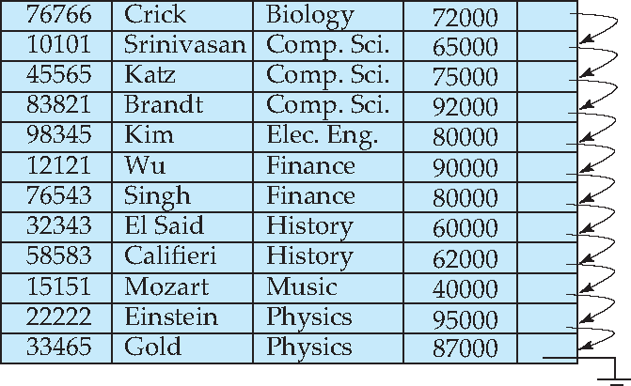
Sequential File Organization (Cont.)
The search key need not be the primary key.
  Example: the search key below is dept_name, which is NOT the primary

Slide 24

Sequential File Organization (Cont.)
Deletion – use pointer chains
Insertion – locate the position where the record is to be inserted
  if there is free space insert there
  if no free space, insert the record in an overflow block
  In either case, pointer chain must be updated
Need to reorganize the file
from time to time to restore
sequential order

Slide 25



Multitable Clustering File Organization
Store several relations in one file using a multitable clustering file organization
department
instructor
Multitable clustering
of department and
instructor

Slide 26

Multitable Clustering File Organization (cont.)
Good for queries involving department instructor, and for queries involving one single department and its instructors
Bad for queries involving only department
Results in variable size records
Can add pointer chains to link records of a particular relation

Slide 27
Data Dictionary Storage
The Data dictionary (also called system catalog) stores metadata; that is, data about data, such as
Information about relations
  names of relations
  names, types and lengths of attributes of each relation
  names and definitions of views
  integrity constraints
User and accounting information, including passwords
Statistical and descriptive data
  number of tuples in each relation
Physical file organization information
  How relation is stored (sequential/hash/…)
  Physical location of relation
Information about indices (Chapter 11)

Slide 28
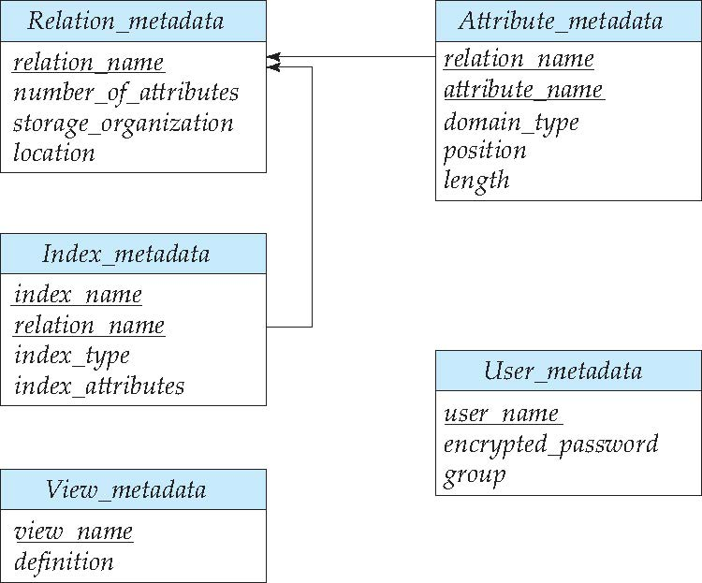
Relational Representation of System Metadata
Relational representation on disk
Specialized data structures designed for efficient access, in memory

Slide 29
End of Module 11

